Slide 1
Software Engineering
Nishat Tasnim Sithy
Lecturer
Dept of CSE
Eastern University

Slide 2
Software Engineering
Software Engineering is the process of designing, developing, testing, and maintaining software.
Applies engineering principles and knowledge of programming languages to build software solutions for end users.

Slide 3
Why Software Engineering is Required?
To manage Large software
For more Scalability
Cost Management
To manage the dynamic nature of software
For better quality Management

Slide 4
Key Principles of Software Engineering
Modularity : Breaking the software into smaller, reusable components
Abstraction : Hiding the implementation details.
Encapsulation : Wrapping up the data and functions of an object into a single unit.
Reusability : Creating components that can be used in multiple objects.
Maintenance : Regularly updating and improving the software to fix bugs.
Testing : Verifying that the software meets its requirement

Slide 5
Software Quality and Stakeholders
Customer (those who pay):
User:
solves problems at
easy to learn;
an acceptable cost in
efficient to use;
terms of money paid and
helps get work done
resources used
QUALITY
SOFTWARE
Developer:
Development manager:
easy to design;
sells more and
easy to maintain;
pleases customers
easy to reuse its parts
while costing less
to develop and maintain

Slide 6
The Nature of Software
Intangibility: Software lacks physical form, making quality assessment and effort estimation difficult.
Low Duplication Cost: Software is easy to reproduce.
  Cost is in its development
    in other engineering products, manufacturing is the costly stage
Labor-Intensive Industry: Hard to automate

Slide 7
The Nature of Software
Complexity & Maintainability Issues: Poorly structured code is hard to understand and modify.
Modification Challenges: Modifying it without introducing errors is difficult due to its complexity.
Deterioration Over Time: Software doesn’t wear out but degrades over time due to repeated modifications:
  Erroneously
  In ways that are not anticipated thus making it complex

Slide 8
Types of Software
Custom Software : Developed for a specific client or organization, tailored to unique needs.
  Eastern University Web Portal
  Bangladesh Railway Ticketing System
  Banking Software

Slide 9
Types of Software
Generic Software: Designed for mass use, sold commercially , and driven by market demand.
  Also often called Commercial Off-The-Shelf Software (COTS)
    Microsoft Office
    Google Chrome
    Spotify

Slide 10
Types of Software
Embedded Software: Runs on specific hardware devices, often non-upgradable without replacing the hardware.
  Smartphone OS
  Washing Machine Software
  Digital Utility Meters
iOS – embedded software
Spotify – generic software

Slide 11
Comparison
Category | Custom Software | Generic Software | Embedded Software
How many copies are used? | Low | High | Medium
How much processing power is needed? | Low | High | Medium
How much effort goes into development? | High ( Security/ authentication ) | High | Medium

Slide 12
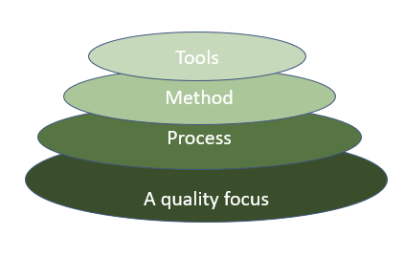
Layered Technology:
Software development has layers to it:
  All layers are connected:
Fig: The diagram shows the layers of software development

Slide 13
Layered Technology
Quality Focus: Ensures continuous improvement, security maintainability, and usability of the software.
Process: The framework that defines software development.
Method: Techniques for analysis, design, coding, and testing.
Tools: Automated or manual computer programs for software development.

Slide 14
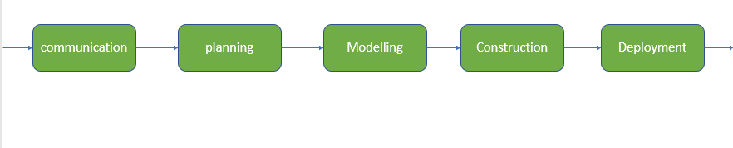
Process Framework
It is the foundation or base layer of software engineering
Process defines a framework that must be established for the effective delivery of software engineering technology
Figure : Activities of the Process Framework

Slide 15
Process Activities
Communication: It is the first and foremost thing for the development of software. Communication is necessary to know the actual demand of the client.
Planning: It basically means drawing a map to reduce the development complication.
Modeling: In this process, a model is created according to the client for better understanding.
Construction: It includes the coding and testing of the problem.
Deployment:- It includes delivering software to the client for evaluation and feedback.

Slide 16
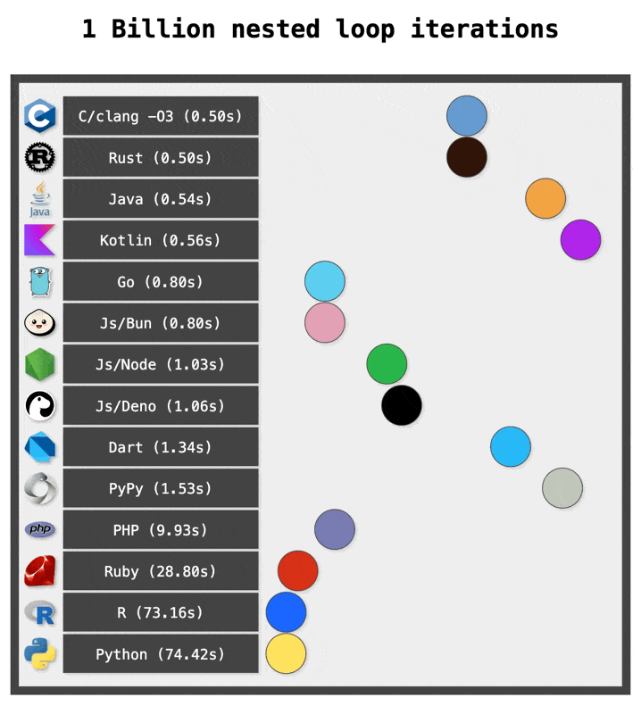
Comparison of different languages

Slide 17
The CMMI (Capability Maturity Model Integration)
Framework used to improve and assess the processes of software development (a quantifiable standard to measure their development level)
5 Maturity Levels ( Initial, Managed, Defined, Quantitively Managed, Optimizing)
Why?
Reduce risk
Enhance Productivity
Encourage Efficient Behavior
Improve Process

Slide 18
Objectives Of CMMI
Fulfilling customer needs and expectations.
Value creation for investors/stockholders.
Market growth is increased.
Improved quality of products and services.
Enhanced reputation in Industry.

Slide 19
Maturity Levels
Level 1 – Initial:
  Processes are unpredictable, poorly controlled, and reactive.
  Projects tend to fail without clear structure or planning.
Level 2 – Managed:
  Processes are planned and tracked, with more stability and predictability.
  Projects are managed by the use of basic project management processes.

Slide 20
Maturity Levels
Level 3 – Defined:
  Processes are well-documented and standardized across the organization.
Level 4 – Quantitatively Managed:
  At this level, processes are measured and controlled using quantitative data.
  The organization uses data to manage and predict the performance of the processes.

Slide 21
Maturity Levels
Level 5 – Optimizing:
  Processes are continuously improved based on a quantitative understanding of process performance.
  The focus is on optimizing and fine-tuning processes for even better results.

Slide 22
To conclude…..
Definition:
  The process of solving customers’ problems by the systematic development and evolution of large, high-quality software systems within cost, time and other constraints.

Slide 23
THANK YOU

